Slide 1
A-Caring for yourself, your family and your community

Slide 2
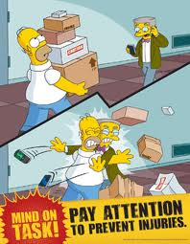
A1-Identify the relationship between high-risk behaviours and resulting consequences
Define the following terms:
-Incident
-Accident
-Injuries
What is meant by injury prevention?

Slide 3
Incident | An incident is an individual occurrence or event.
Accident | An accident is an unforeseen and unplanned event or circumstance, often with lack of intention or necessity. It implies a generally negative outcome which may have been avoided or prevented had circumstances leading up to the accident been recognized, and acted upon, prior to its occurrence.
Injuries | An injury is harm or damage to oneself. Injuries include unintentional injuries, such as those caused by motor vehicle crashes, drowning, falls, and fires, and intentional injuries, such as suicide and violence.

Slide 4
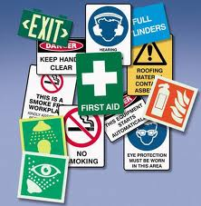
Prevention
Injuries are preventable by changing the environment, individual behavior, products, social norms, legislation and governmental and institutional policies to reduce or eliminate risks and increase protective factors.

Slide 5
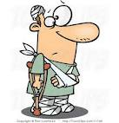
Accident Report
Describe an accident you know (or find one in the newspaper).
Who was involved?
What are the details?
What caused the accident?
What were the consequences?
Were there any hazards?
Describe how this accident could have been prevented.

Slide 6
Adolescent Safety
Most parents and caregivers will have had many talks with their child about basic safety issues by the time the child becomes a teenager. However, talking with adolescents about safety can present new challenges for parents and teens.
During adolescence, teens struggle with separating from their parents, establishing their own identity, and becoming more independent. Adolescents often are influenced by peer pressure and can feel invincible, which may lead them to participate in risky behavior.

Slide 7
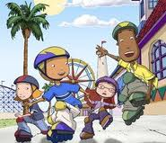
Safety Poster
Adolescent Safety
Drinking and driving, drugs, food safety, sport safety, helmet, car, peer pressure, internet, school violence, relationships, first aid, sun safety, etc.
1. Slogan
2. Drawing (color)

Slide 8
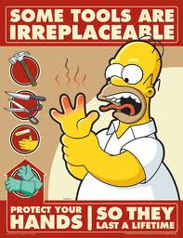
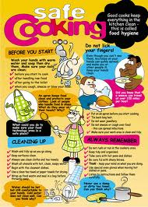

Slide 9
